Slide 1
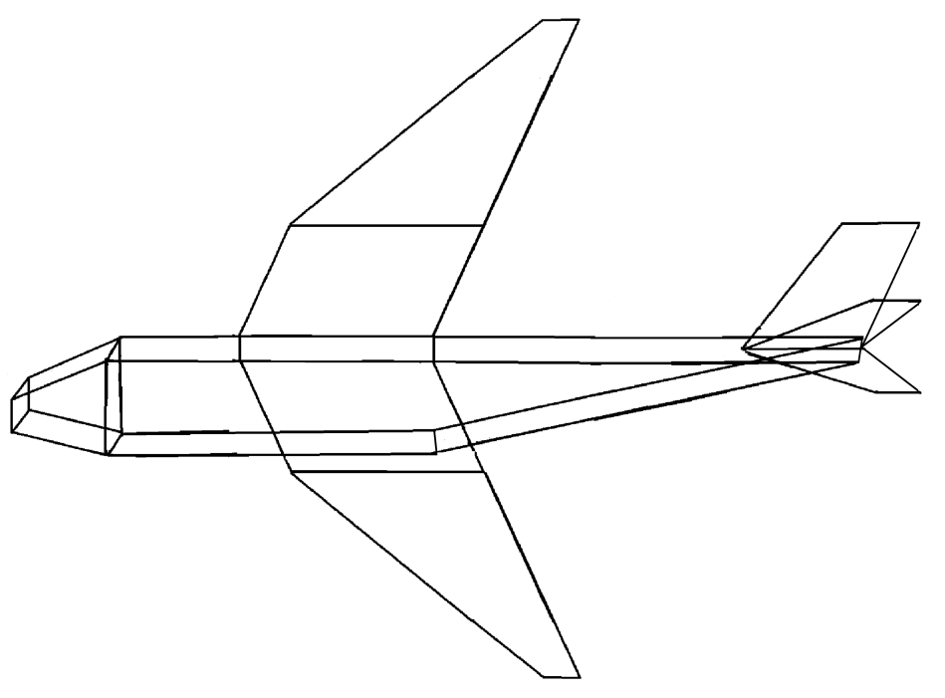
у
X0 + 6m; y0 + 2m; z0 - m
X0 + 14m; y0 + 2m; z0 – 12m
X0 + 8m; y0 + 2m; z0 – 5m
X0 + 15m; y0 + 2m; z0 – 12m
X0 + 6m; y0 + 2m; z0
X0 + 19m; y0 + 2m; z0 - 0,5m
X0 + 22m; y0 + 6m; z0 - 0,5m
X0 + 3m; y0 + 2m; z0 - m
11
12
X0 + 24m; y0 + 6m; z0 - 0,5m
X0 + 3m; y0 + 2m; z0
X0 + 12m; y0 + 2m; z0 – 5m
X0 + 22m; y0 + 2m; z0 - 2m
X0 ; y0 + m; z0 - m
10
13
30
31
X0 + 24m; y0 + 2m; z0 - 2m
X0; y0 + m; z0
X0 + 11m; y0 + 2m; z0 - m
29
4
8
14
23
28
X0 + 22m; y0 + 2m; z0 - 0,5m
2
5
9
15
24
22
25
X0; y0 ; z0 - m
1
3
7
20
27
26
X0 + 24m; y0 + 2m; z0 + m
0
6
21
19
X
X0; y0; z0
16
X0 + 11m; y0 + 2m; z0
X0 + 22m; y0 + 2m; z0 + m
x0 + 3m; y0 - m; z0 - m
X0 + 11m; y0 - m; z0 - m
X0 + 3m; y0 - m; z0
17
18
X0 + 22m; y0 + 2m; z0 - m
X0 + 22m; y0 + 2m; z0
X0 + 12m; y0 + 2m; z0 + 4m
Z
X0 + 8m; y0 + 2m; z0 +4m
X0 + 11m; y0 - m; z0
X0 + 15m; y0 + 2m; z0 + 11m
X0 + 14m; y0 + 2m; z0 +11m

Slide 2
0. х0; y0; z0
1. х0; y0 + m; z0
2. х0 ; y0 + m; z0 - m
3. х0; y0 ; z0 - m
4. х0 + 3m; y0 + 2m; z0 - m
5. х0 + 3m; y0 + 2m; z0
6. х0 + 3m; y0 - m; z0
7. x0 + 3m; y0 - m; z0 - m
8. х0 + 6m; y0 + 2m; z0 - m
9. х0 + 6m; y0 + 2m; z0
10. х0 + 8m; y0 + 2m; z0 – 5m
11. х0 + 14m; y0 + 2m; z0 – 12m
12. х0 + 15m; y0 + 2m; z0 – 12m
13. х0 + 12m; y0 + 2m; z0 – 5m
14. х0 + 11m; y0 + 2m; z0 - m
15. х0 + 11m; y0 + 2m; z0
16. х0 + 8m; y0 + 2m; z0 +4m
17. х0 + 14m; y0 + 2m; z0 +11m
18. х0 + 15m; y0 + 2m; z0 + 11m
19. х0 + 12m; y0 + 2m; z0 + 4m
20. х0 + 11m; y0 - m; z0 - m
21. х0 + 11m; y0 - m; z0
22. х0 + 22m; y0 + 2m; z0
23. х0 + 22m; y0 + 2m; z0 - m
24. х0 + 19m; y0 + 2m; z0 - m/2
25. х0 + 22m; y0 + 2m; z0 - m/2
26. х0 + 24m; y0 + 2m; z0 + m
27. х0 + 22m; y0 + 2m; z0 + m
28. х0 + 24m; y0 + 2m; z0 - 2m
29. х0 + 22m; y0 + 2m; z0 - 2m
30. х0 + 22m; y0 + 6m; z0 - m/2
31. х0 + 24m; y0 + 6m; z0 - m/2

